Slide 1
Make a book for the Portico Sadie Massey Awards Art of the Book Competition!

Slide 2
Who is it for?
A competition for Key Stage 3, 4 or 5 students attending Pupil Referral Units and schools and departments with special educational needs in Greater Manchester.
The aim of the competition is to support wellbeing, confidence and identity through exploring a place, an interest, or personal experience. Also to encourage writing, reading and visual communications skills through the creation of a book.
Students may prefer to work on their own or they may wish to work as part of a group. The maximum number of students to a group is four, and teaching staff may support students to access the task. All entries will be considered equally.

Slide 3
How to enter
Craft a book with a story inside. Make the book about you and where you live.
You can use images, or words, or both. Tell us your story your way.
To enter, you can post your book, take photographs of it or use a phone to make a simple video of your book. If a video, show only your hands turning the pages so we can see inside. Make sure you show every page, including the front cover and the back. Posted books will be returned.
If your entry is by photographs or a video, please do not show your face or anyone else’s.
To submit video entries, please email the video as an MP4 video to psma@theportico.org.uk Please write ‘Art of the Book Award’ in the subject box. By post c/o Ruth Estevez The Portico Library, 57 Mosley Street, Manchester M2 3HY marked ‘Art of the Book Award’
Deadline midnight, Friday 16 February 2024.
Make sure you fill out an entry form for every book submitted and include in the email.

Slide 4
Need some examples?
This video gives you an example of how we would like to receive the video entries. Just show a hand turning the pages of the book so we can see nice and clearly: https://youtu.be/O-Y4dP1PpWc
Students can make a book about themselves! Here’s another great resource: https://www.bl.uk/childrens-books/activities/the-book-of-me
This video shows you how to make a mini-book. Don’t worry if yours looks different. You can use different materials, make it bigger, bind it with staples, we don’t mind! https://www.bl.uk/childrens-books/videos/make-a-mini-book

Slide 5
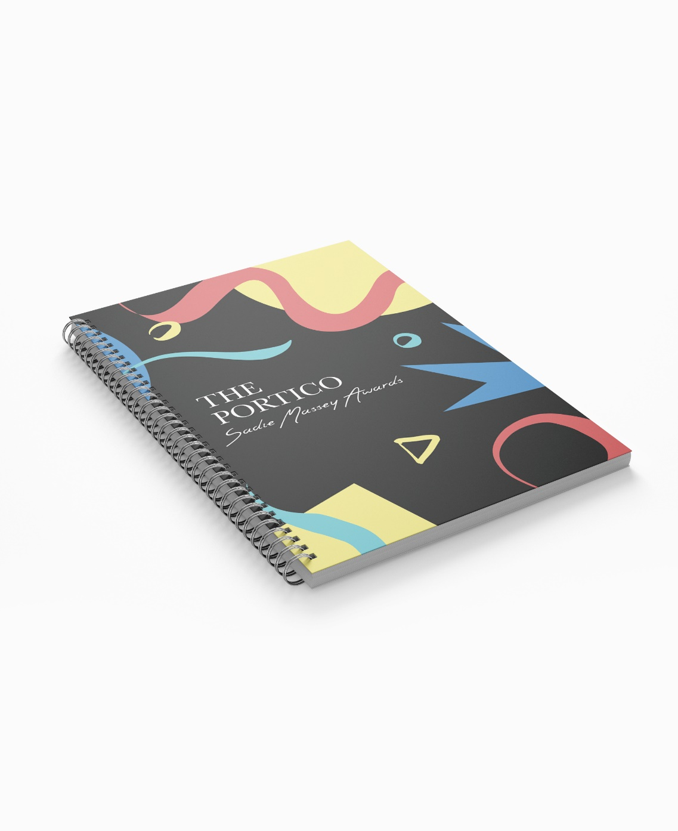
Prizes
Winners can choose their own book from Read Manchester at the presentation event, receive a certificate and The Portico Sadie Massey Awards’ notebook and bookmark!
All schools that enter can choose a copy of a book for their library too!
We will announce the winners on our website and direct emails to schools and hold a presentation event in Manchester’s Central Library on Friday, 15 March, 1.30 – 2.30 pm, deliver prizes to schools in person or by post. Whatever works best for you!

Slide 6
We can’t wait to see your books and read your stories!
https://www.theportico.org.uk/portico-sadie-massey-awards
Closing date: Midnight 16 February 2024
Any more questions? Contact: psma@theportico.org.uk

